Slide 1
ANALYZING AMAZON'S CO-PURCHASING NETWORK WITH APACHE SPARK
Submitted By
Rishabh Gautam: 20bcs112
Dipesh Mishra: 20bcs043
mahendra pooniya: 20bcs082
Ravikant: 20bcs110
Under the Guidance of
Dr. Animesh Chathurvedi

Slide 2
INTRODUCTION
1
OBJECTIVE
2
DATASET
Content
3
ALGORITHM
4
RESULTS
5
CONCLUSION
6

Slide 3

INTRODUCTION
In the age of big data, the Amazon Product Co-purchasing Network, collected in June 2003, offers a valuable window into customer behavior on the Amazon platform. This report leverages Apache Spark to analyze the dataset, using the Connected Components algorithm to uncover patterns in product co-purchasing behavior. By doing so, we aim to reveal clusters of related products, providing insights that can drive more effective recommendation systems and marketing strategies.
In the subsequent sections, we'll delve into the dataset, explore the Apache Spark-powered analysis, and discuss the practical implications of our findings.

Slide 4

OBJECTIVE
The objectives of this analysis are to provide an overview of the Amazon Product Co-purchasing Network, utilizing the Connected Components algorithm in Apache Spark's GraphX library to identify clusters of interrelated products. The analysis seeks to uncover patterns in co-purchasing behavior and explore the potential implications for recommendation systems, marketing strategies, and customer behavior analysis. It highlights the significance of Apache Spark in efficiently processing and analyzing large-scale network data, emphasizing its role in data-driven decision-making for e-commerce applications.

Slide 5
Network was collected by crawling Amazon website. It is based on Customers Who Bought This Item Also Bought feature of the Amazon website. If a product i is frequently co-purchased with product j, the graph contains a directed edge from i to j.
Dataset statistics Nodes 403394 Edges 3387388 Nodes in largest WCC 403364 (1.000) Edges in largest WCC 3387224 (1.000) Nodes in largest SCC 395234 (0.980) Edges in largest SCC 3301092(0.975) Average clustering coefficient 0.4177 Number of triangles 3986507 Fraction of closed triangles 0.06206 Diameter (longest shortest path) 21 90-percentile effective diameter 7.6
DataSet

Slide 6


ALGORITHM
Steps
1
Load the Graph
2
construct the graph
3
Run the connected component algorithm
4
Extract Component IDs

Slide 7
ALGORITHM
Steps
7
Print or Analyze the Results
8
Stop the Spark Context
5
Calculate Component Size
6
Sort Component

Slide 8


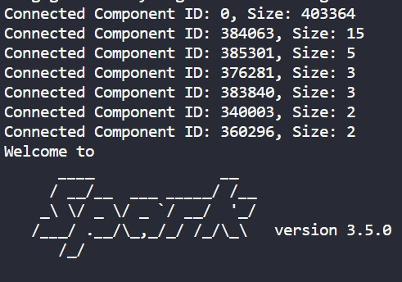
Result

Slide 9






Conclusion
10
In conclusion, the analysis of the Amazon Product Co-purchasing Network through Apache Spark and the Connected Components algorithm has provided valuable insights into customer behavior on the Amazon platform. We have successfully identified interconnected clusters of products, shedding light on patterns of co-purchasing and potential recommendations. The application of Apache Spark has demonstrated its efficiency in processing large-scale network data, emphasizing its role in data-driven decision-making for e-commerce. The findings have practical implications for improving recommendation systems, marketing strategies, and understanding customer preferences, ultimately contributing to a more satisfying and efficient shopping experience for Amazon customers. This analysis underscores the power of modern data science tools in unlocking actionable insights from extensive datasets.

Slide 10




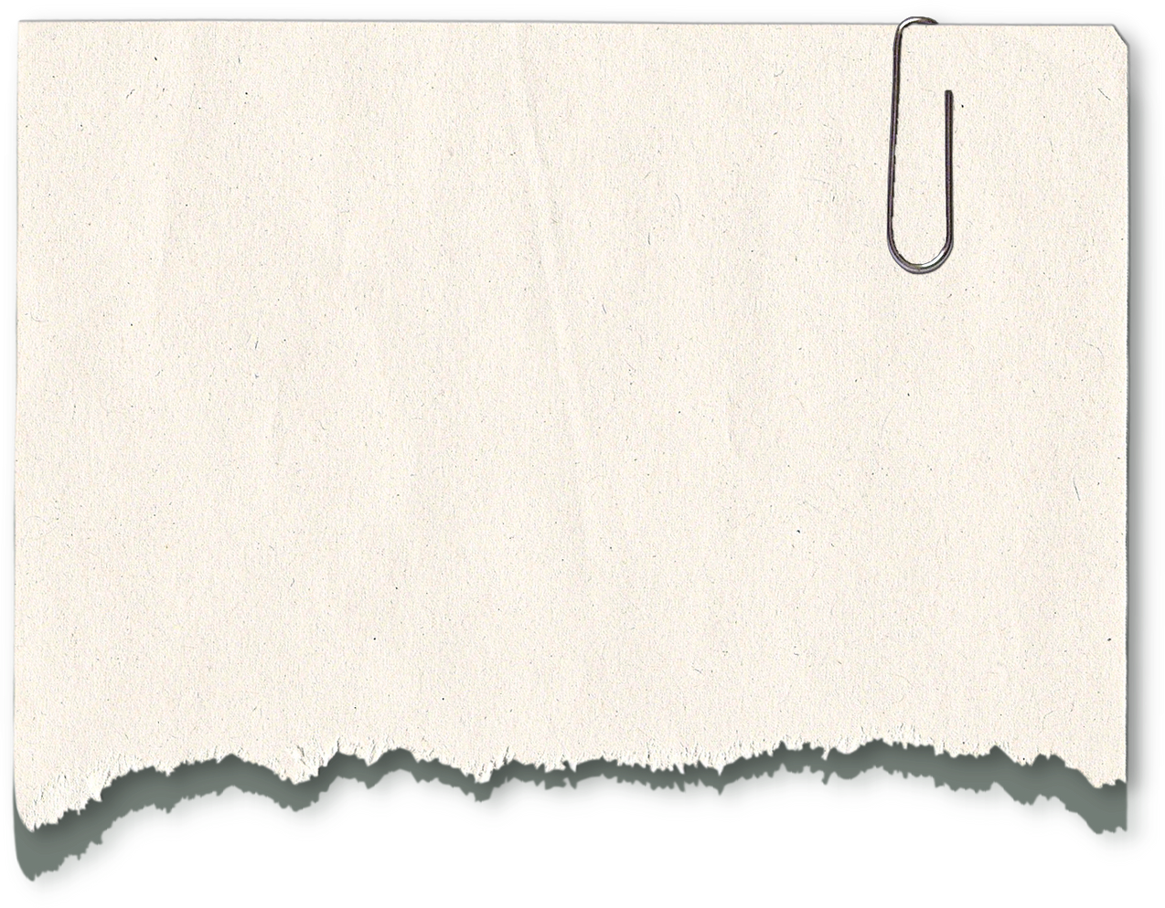


WWW.REALLYGREATSITE.COM
Thank
you

